Slide 1

Paradox
AgriTech
Crop-Mate
Anognya Reddy
Sirichandana
Amrutha Varshini
None

Slide 2
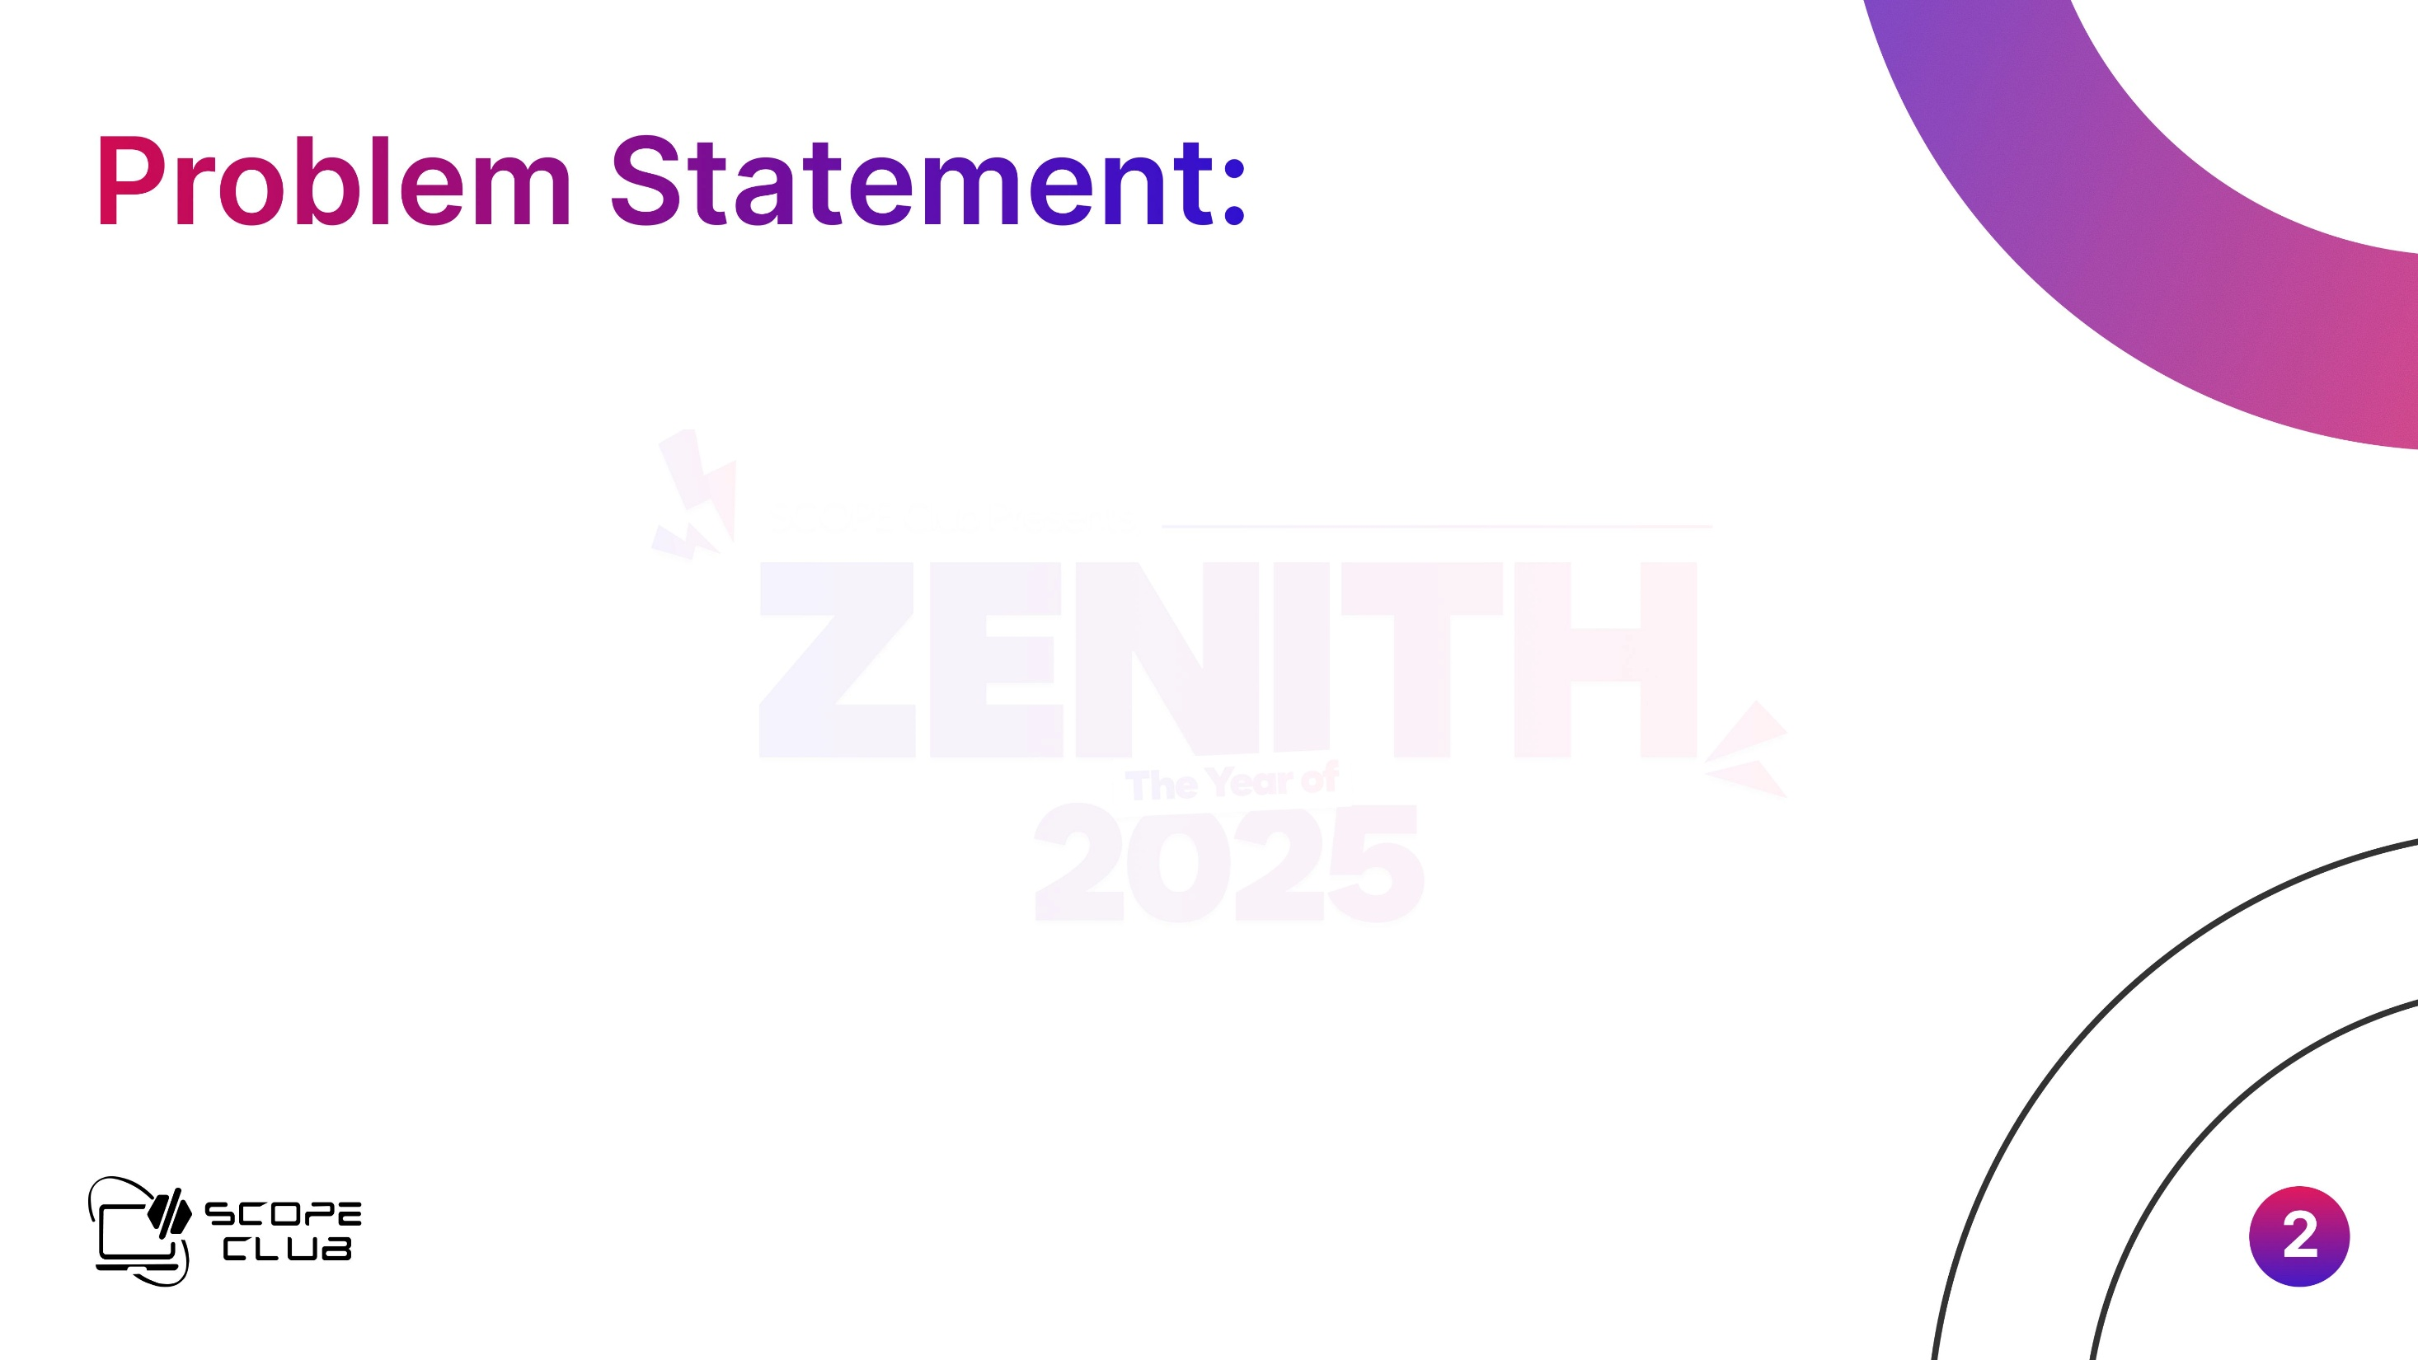
Farmers often struggle to choose the right crops, predict seasonal changes, and identify soil needs.
Most existing tools require strong internet connectivity, which rural communities often lack.
Crop-Mate aims to bridge this gap by offering reliable, region‑specific support even in offline environments.

Slide 3

Crop-Mate is an on-device farming assistant that gives crop recommendations, soil insights, and pest alerts.
It works smoothly even with weak connectivity and adapts to local climate and soil patterns.

Slide 4

Python, TensorFlow Lite
Dataset preprocessing in Pandas
Data Collection & Preprocessing
Lightweight On-Device Machine Learning
Rule-Based Pest & Disease Alerts
Offline-First System Design
User-Centric Interface
Modular Architecture for Future Expansion

Slide 5

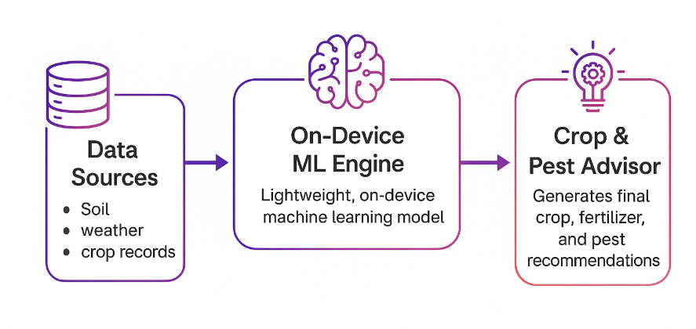

Slide 6

Designed to be lightweight, Crop-Mate performs efficiently even on basic smartphones commonly used in rural areas.
Its offline functionality ensures farmers can access guidance anytime, regardless of internet availability.
The system is easily scalable, allowing new districts or regions to be added by integrating their local soil and climate datasets.
Built with a modular architecture, Crop-Mate can be expanded over time with additional features and improved models without disrupting existing functionality.

Slide 7

Helps farmers make confident decisions
Reduces crop loss by early warnings
Supports sustainable farming practices
Works in areas with limited connectivity
Accessible and easy to learn

